Slide 1
COMP 2230
Week 6 - Monday

Slide 2
Last time
Recurrence relations
Solving recurrence by iteration

Slide 3
Questions?

Slide 4
Assignment 2

Slide 5
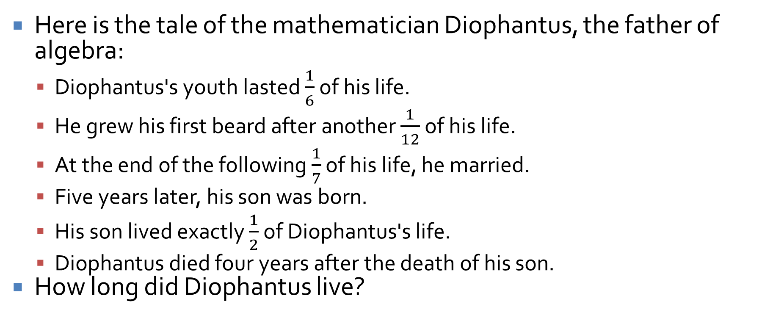
Logical warmup
Here is the tale of the mathematician Diophantus, the father of algebra:
Diophantus's youth lasted $\frac{1}{6}$ of his life.
He grew his first beard after another $\frac{1}{12}$ of his life.
At the end of the following $\frac{1}{7}$ of his life, he married.
Five years later, his son was born.
His son lived exactly $\frac{1}{2}$ of Diophantus's life.
Diophantus died four years after the death of his son.
How long did Diophantus live?

Slide 6
Solving Second-Order Linear Homogeneous Relations with Constant Coefficients

Slide 7
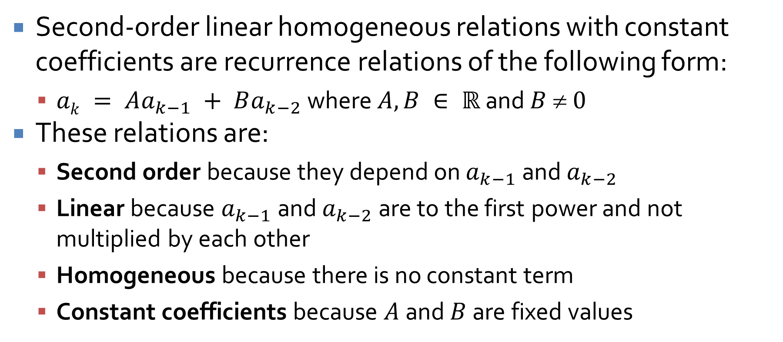
Second-Order Linear Homogeneous Relations with Constant Coefficients
Second-order linear homogeneous relations with constant coefficients are recurrence relations of the following form:
$ak = Aa_{k−1} + Ba_{k−2}$ where $A, B ∈ ℝ$ and $B  0$
These relations are:
Second order because they depend on $a_{k−1}$ and $a_{k−2}$
Linear because $a_{k−1}$ and $a_{k−2}$ are to the first power and not multiplied by each other
Homogeneous because there is no constant term
Constant coefficients because $A$ and $B$ are fixed values

Slide 8
Why do we care?
I'm sure you're thinking that this is an awfully narrow class of recurrence relations to have special rules for
It's true: There are many (infinitely many) ways to formulate a recurrence relation
Some have explicit formulas
Some do not have closed explicit formulas
We care about this one partly for two reasons
We can solve it
It lets us get an explicit formula for Fibonacci!

Slide 9
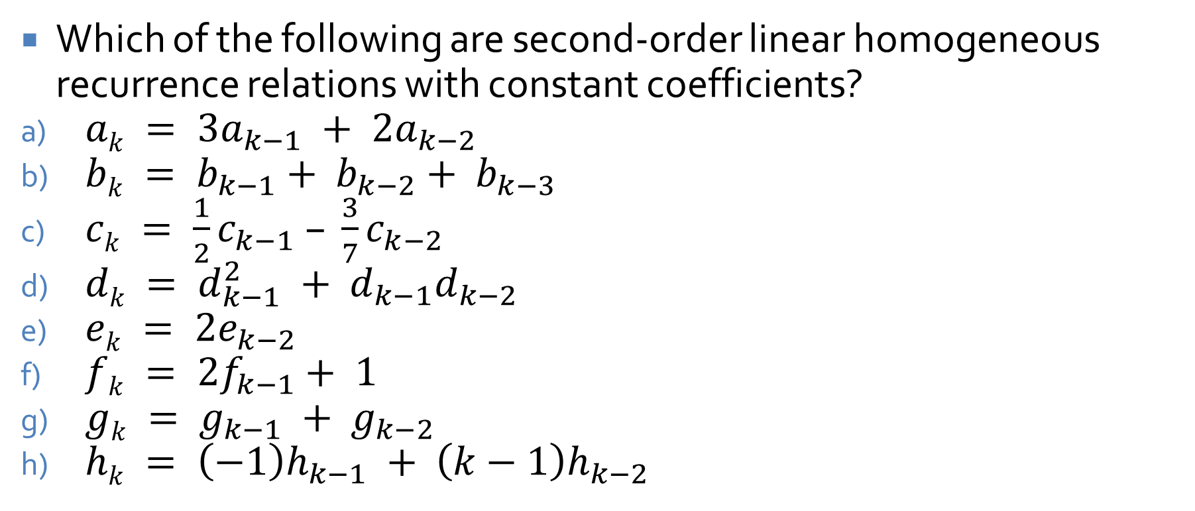
Pick 'em out
Which of the following are second-order linear homogeneous recurrence relations with constant coefficients?
$ak = 3a_{k−1} + 2a_{k−2}$
$bk = b_{k−1}+ b_{k−2}+ b_{k−3}$
$ck = \frac{1}{2}c_{k−1} – \frac{3}{7}c_{k−2}$
$dk = d_{k−1}^{2} + d_{k−1}d_{k−2}$
$ek = 2e_{k−2}$
$fk = 2f_{k−1}+ 1$
$gk = g_{k−1} + g_{k−2}$
$hk = \left(−1\right)h_{k−1} + \left(k−1\right)h_{k−2}$

Slide 10
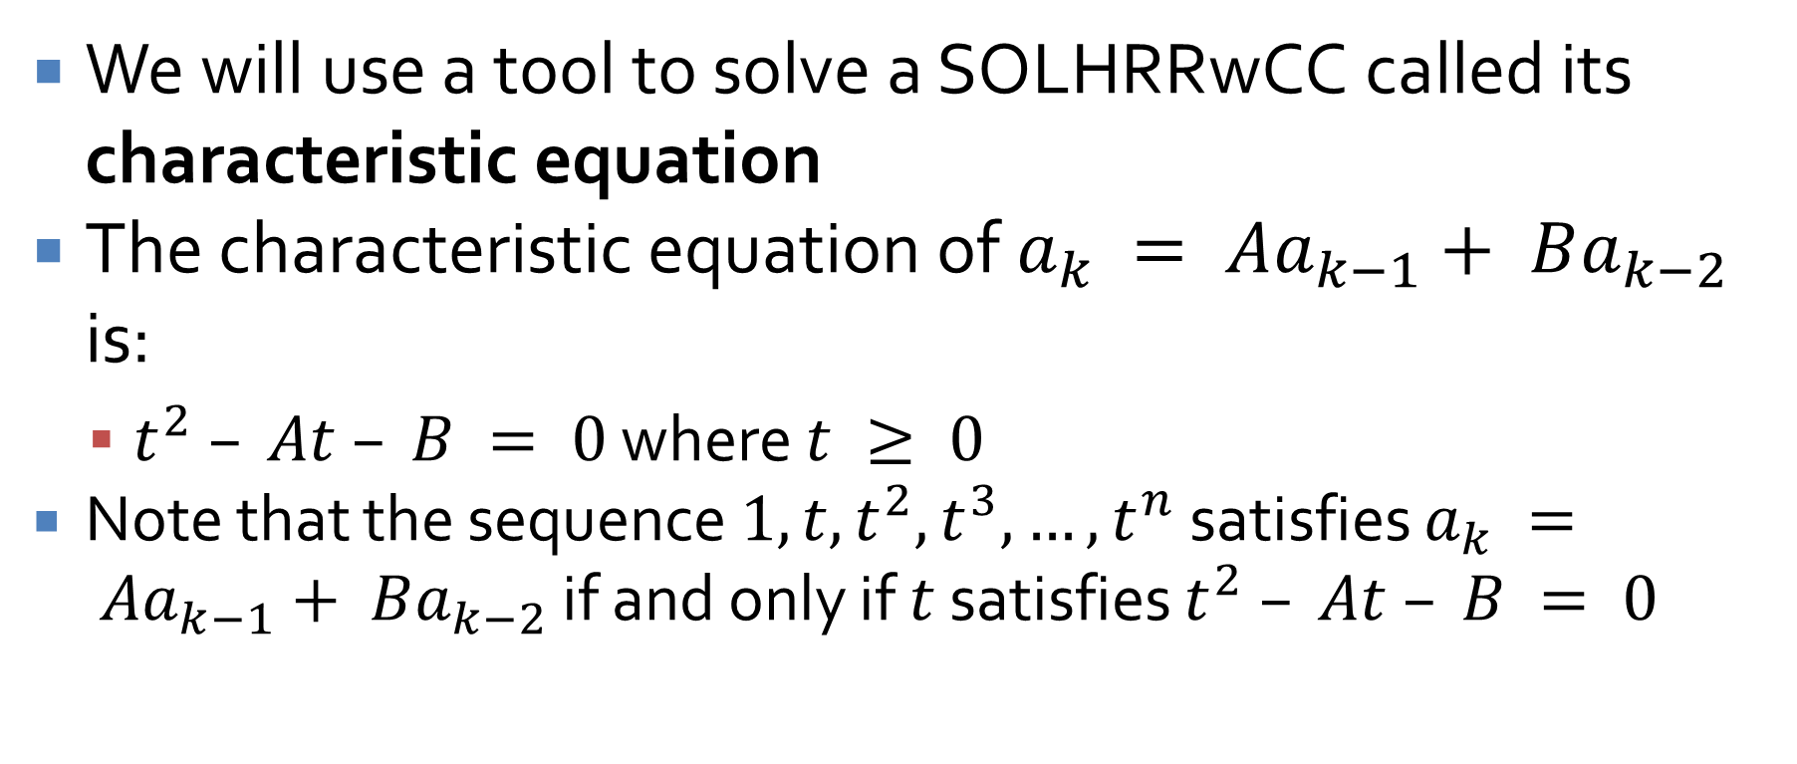
Characteristic equation
We will use a tool to solve a SOLHRRwCC called its characteristic equation
The characteristic equation of $a_{k} = Aa_{k−1}+ Ba_{k−2}$ is:
$t^{2} – At – B = 0$ where $t ≥ 0$
Note that the sequence $1, t, t^{2}, t^{3}, …, t^{n}$ satisfies $a_{k} = Aa_{k−1}+ Ba_{k−2}$ if and only if $t$ satisfies $t^{2} – At – B = 0$

Slide 11
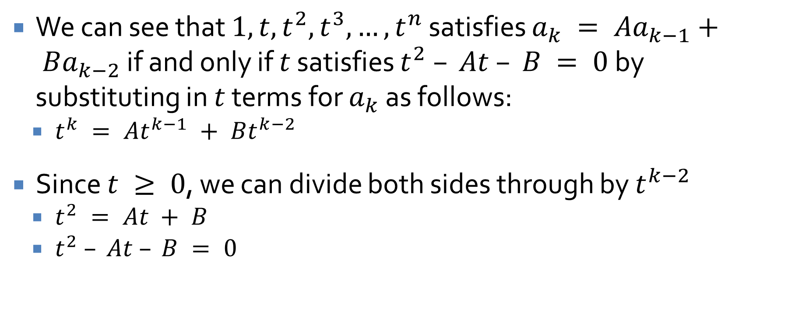
Demonstrating the characteristic equation
We can see that $1, t, t^{2}, t^{3}, …, t^{n}$ satisfies $a_{k} = Aa_{k−1}+ Ba_{k−2}$ if and only if $t$ satisfies $t^{2} – At – B = 0$by substituting in $t$ terms for $a_{k}$ as follows:
$t^{k} = At^{k−1} + Bt^{k−2}$
Since $t ≥ 0$, we can divide both sides through by $t^{k−2}$
$t^{2} = At + B$
$t^{2} – At – B = 0$

Slide 12
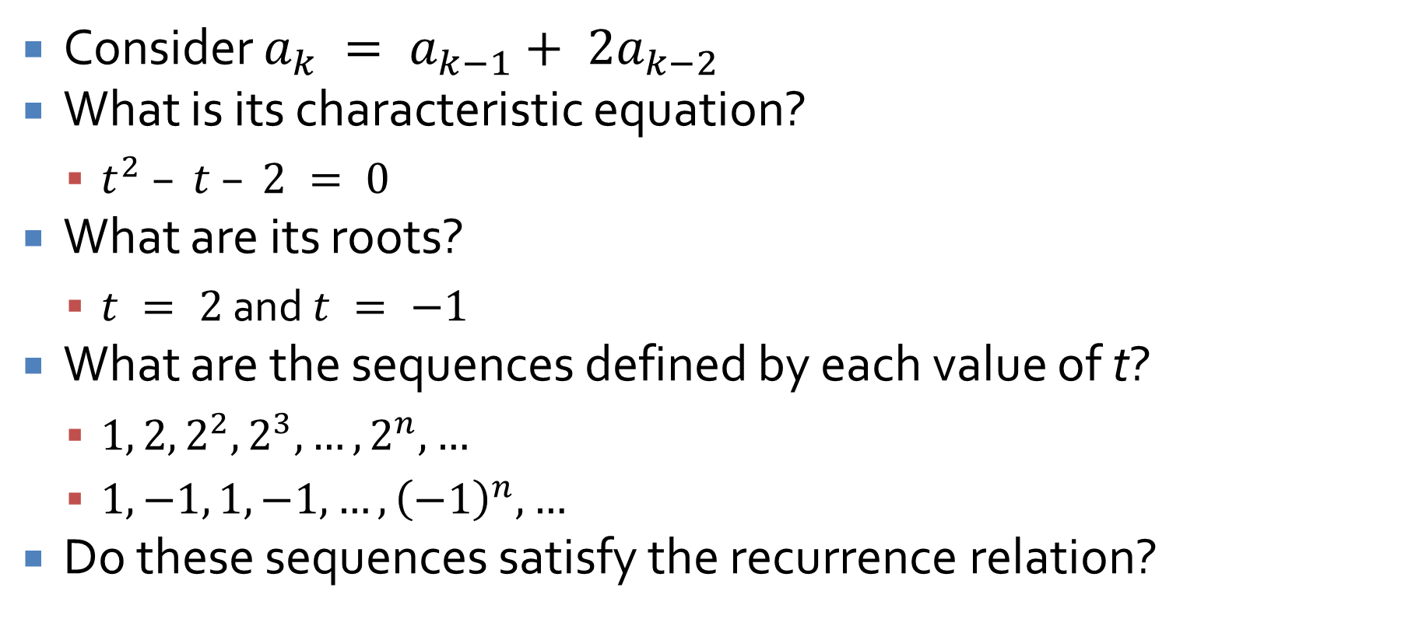
Using the characteristic equation
Consider $a_{k} = a_{k−1}+ 2a_{k−2}$
What is its characteristic equation?
$t^{2} – t – 2 = 0$
What are its roots?
$t = 2$ and $t = −1$
What are the sequences defined by each value of t?
$1, 2, 2^{2}, 2^{3}, …, 2^{n}, …$
$1, −1, 1, −1, …, {\left(−1\right)}^{n}, …$
Do these sequences satisfy the recurrence relation?

Slide 13
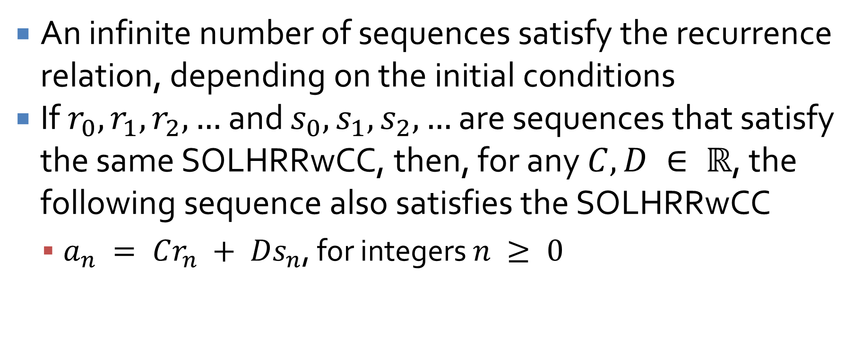
Finding other sequences
An infinite number of sequences satisfy the recurrence relation, depending on the initial conditions
If $r_{0}, r_{1}, r_{2}, …$ and $s_{0}, s_{1}, s_{2}, …$ are sequences that satisfy the same SOLHRRwCC, then, for any $C, D ∈ ℝ$, the following sequence also satisfies the SOLHRRwCC
$a_{n} = Cr_{n} + Ds_{n}$, for integers $n ≥ 0$

Slide 14
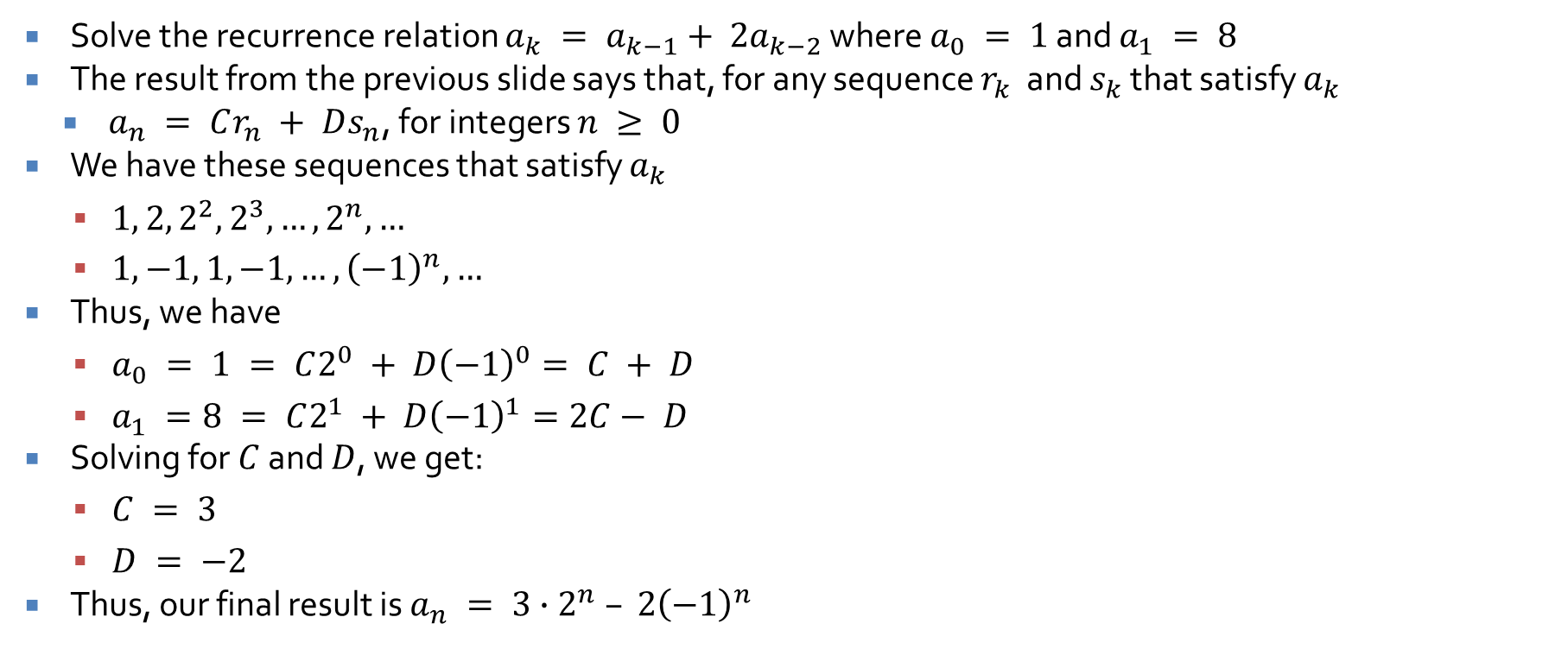
Finding a sequence with specific initial conditions
Solve the recurrence relation $a_{k} = a_{k−1}+ 2a_{k−2}$ where $a_{0} = 1$ and $a_{1} = 8$
The result from the previous slide says that, for any sequence $r_{k}$ and $s_{k}$ that satisfy $a_{k}$
$a_{n} = Cr_{n} + Ds_{n}$, for integers $n ≥ 0$
We have these sequences that satisfy $a_{k}$
$1, 2, 2^{2}, 2^{3}, …, 2^{n}, …$
$1, −1, 1, −1, …, {\left(−1\right)}^{n}, …$
Thus, we have
$a_{0} = 1 = C2^{0} + D{\left(−1\right)}^{0}= C + D$
$a_{1} =8 = C2^{1} + D{\left(−1\right)}^{1}=2C− D$
Solving for $C$ and $D$, we get:
$C = 3$
$D = −2$
Thus, our final result is $a_{n} = 3∙2^{n} – 2{\left(−1\right)}^{n}$

Slide 15
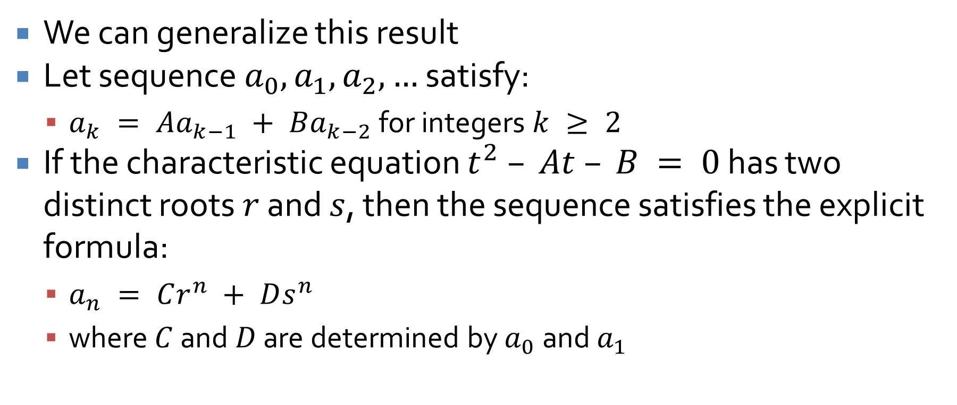
Distinct Roots Theorem
We can generalize this result
Let sequence $a_{0}, a_{1}, a_{2}, …$ satisfy:
$a_{k} = Aa_{k−1} + Ba_{k−2}$ for integers $k ≥ 2$
If the characteristic equation $t^{2} – At – B = 0$ has two distinct roots $r$ and $s$, then the sequence satisfies the explicit formula:
$a_{n} = Cr^{n} + Ds^{n}$
where $C$ and $D$ are determined by $a_{0}$ and $a_{1}$

Slide 16
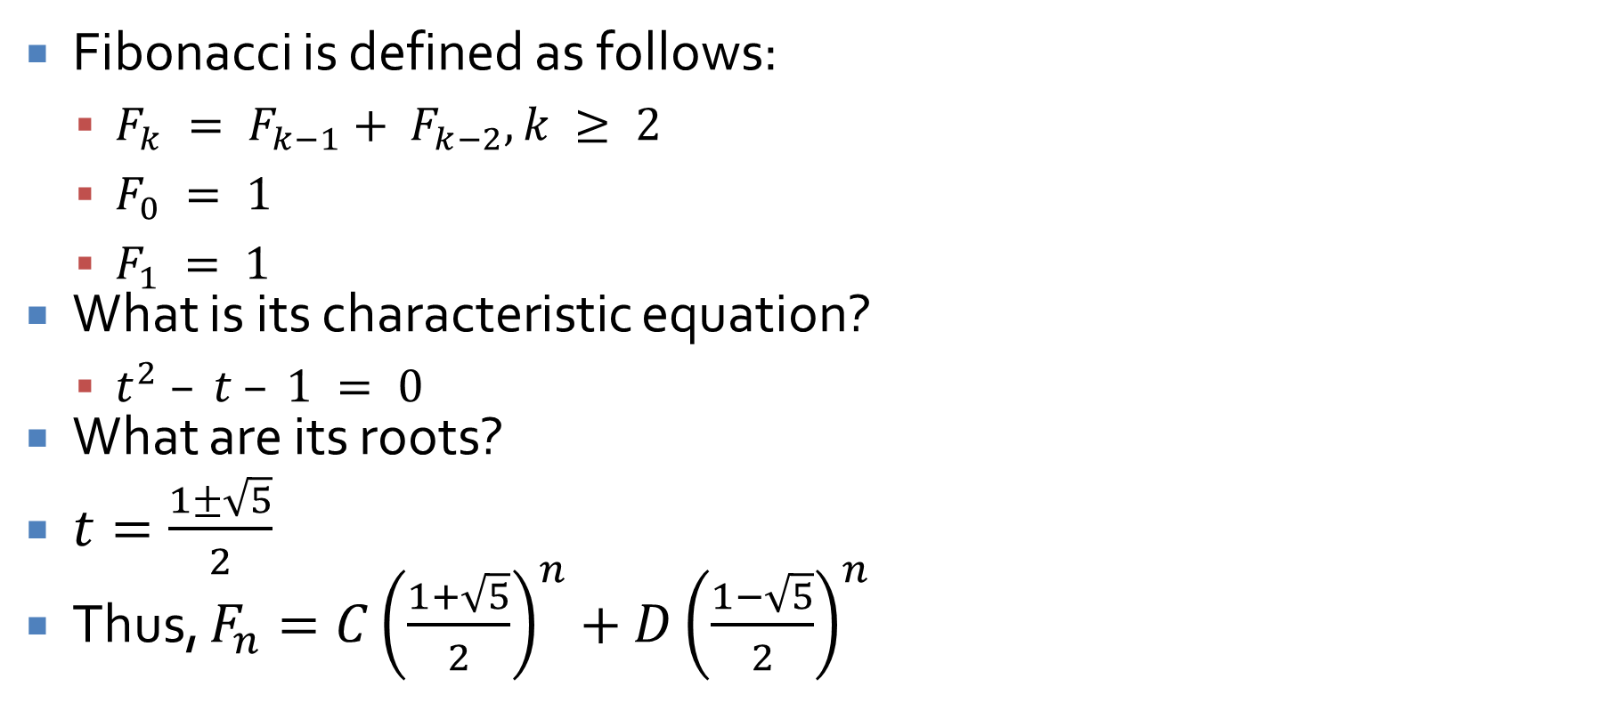
Now we can solve Fibonacci!
Fibonacci is defined as follows:
$F_{k} = F_{k−1}+ F_{k−2}, k ≥ 2$
$F_{0} = 1$
$F_{1} = 1$
What is its characteristic equation?
$t^{2} – t – 1 = 0$
What are its roots?
$t=\frac{1±\sqrt{5}}{2}$
Thus, $F_{n}=C{\left(\frac{1+\sqrt{5}}{2}\right)}^{n}+D{\left(\frac{1−\sqrt{5}}{2}\right)}^{n}$

Slide 17
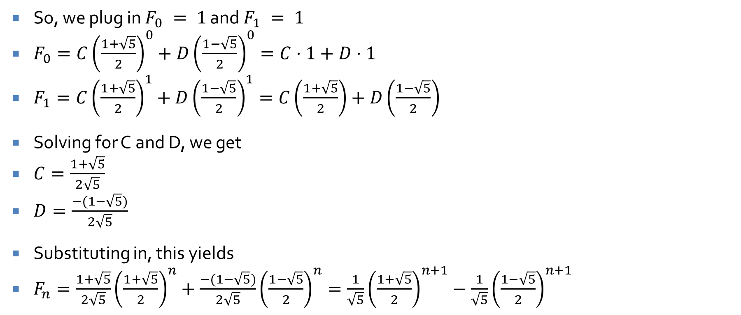

We just need $C$ and $D$
So, we plug in $F_{0} = 1$ and $F_{1} = 1$
$F_{0}=C{\left(\frac{1+\sqrt{5}}{2}\right)}^{0}+D{\left(\frac{1−\sqrt{5}}{2}\right)}^{0}=C⋅1+D⋅1$
$F_{1}=C{\left(\frac{1+\sqrt{5}}{2}\right)}^{1}+D{\left(\frac{1−\sqrt{5}}{2}\right)}^{1}=C\left(\frac{1+\sqrt{5}}{2}\right)+D\left(\frac{1−\sqrt{5}}{2}\right)$
Solving for C and D, we get
$C=\frac{1+\sqrt{5}}{2\sqrt{5}}$
$D=\frac{−(1−\sqrt{5})}{2\sqrt{5}}$
Substituting in, this yields
$F_{n}=\frac{1+\sqrt{5}}{2\sqrt{5}}{\left(\frac{1+\sqrt{5}}{2}\right)}^{n}+\frac{−(1−\sqrt{5})}{2\sqrt{5}}{\left(\frac{1−\sqrt{5}}{2}\right)}^{n}=\frac{1}{\sqrt{5}}{\left(\frac{1+\sqrt{5}}{2}\right)}^{n+1}−\frac{1}{\sqrt{5}}{\left(\frac{1−\sqrt{5}}{2}\right)}^{n+1}$

Slide 18
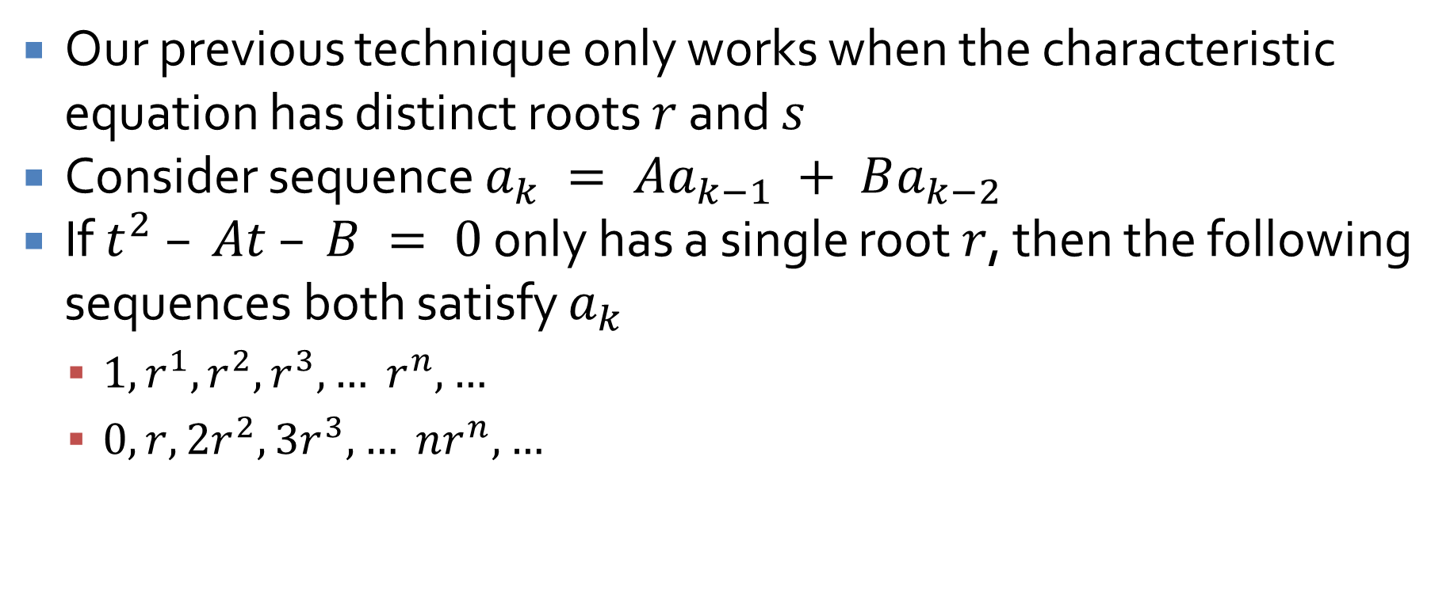
Single-Root Case
Our previous technique only works when the characteristic equation has distinct roots $r$ and $s$
Consider sequence $a_{k} = Aa_{k−1} + Ba_{k−2}$
If $t^{2} – At – B = 0$ only has a single root $r$, then the following sequences both satisfy $a_{k}$
$1, r^{1}, r^{2}, r^{3}, … r^{n}, …$
$0, r, 2r^{2}, 3r^{3}, … nr^{n}, …$

Slide 19
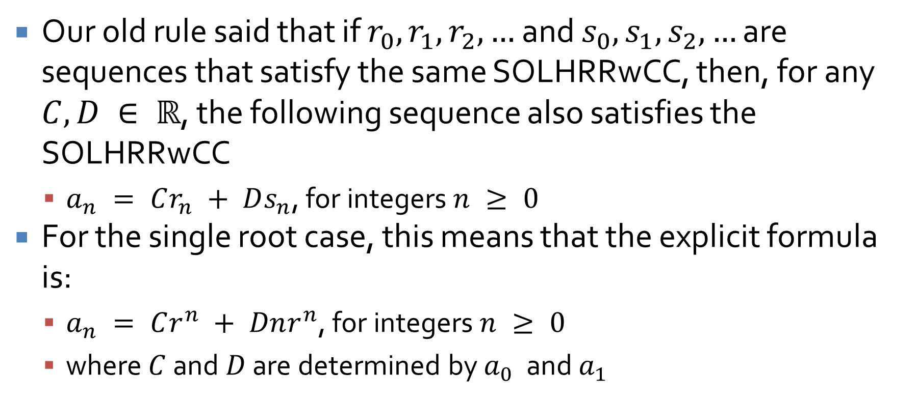
Single root equation
Our old rule said that if $r_{0}, r_{1}, r_{2}, …$ and $s_{0}, s_{1}, s_{2}, …$ are sequences that satisfy the same SOLHRRwCC, then, for any $C, D ∈ ℝ$, the following sequence also satisfies the SOLHRRwCC
$a_{n} = Cr_{n} + Ds_{n}$, for integers $n ≥ 0$
For the single root case, this means that the explicit formula is:
$a_{n} = Cr^{n} + Dnr^{n}$, for integers $n ≥ 0$
where $C$ and $D$ are determined by $a_{0}$ and $a_{1}$

Slide 20
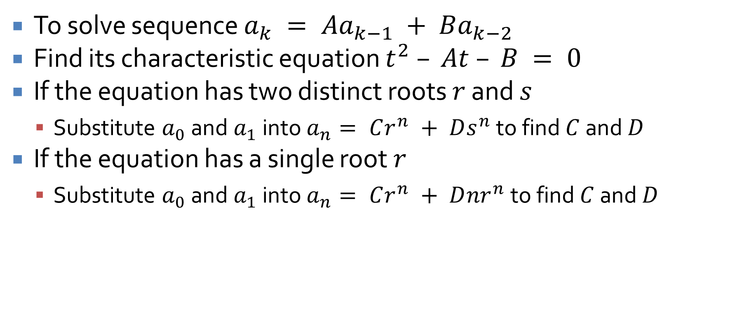
SOLHRRwCC TL;DR
To solve sequence $a_{k} = Aa_{k−1} + Ba_{k−2}$
Find its characteristic equation $t^{2} – At – B = 0$
If the equation has two distinct roots $r$ and $s$
Substitute $a_{0}$ and $a_{1}$ into $a_{n}= Cr^{n} + Ds^{n}$ to find $C$ and $D$
If the equation has a single root $r$
Substitute $a_{0}$ and $a_{1}$ into $a_{n}= Cr^{n} + D{nr}^{n}$ to find $C$ and $D$

Slide 21
General Recursive Definitions

Slide 22
Defining anything recursively
We can define sets recursively
To do so, we need three things:
Base: A statement of that certain things are in the set
Recursion: A set of rules saying how new objects can be shown to be in the set based on ones that are already known to be in the set
Restriction: A statement that no objects belong to the set other than those coming from I and II

Slide 23
Example
The set P of all strings of legal parenthesizations
Base: () is in P
Recursion:
If E is in P, so is (E)
If E and F are in P, so is E F
Restriction: No configurations of parentheses are in P other than those derived from I and II

Slide 24
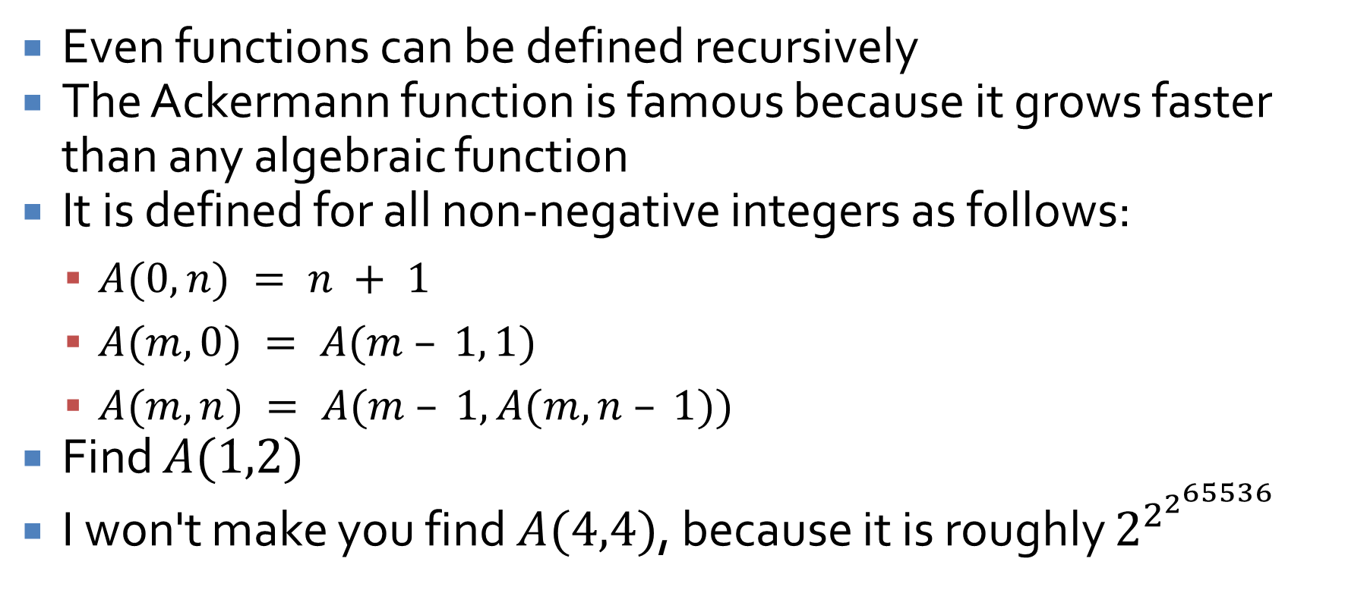
Ackermann function
Even functions can be defined recursively
The Ackermann function is famous because it grows faster than any algebraic function
It is defined for all non-negative integers as follows:
$A(0,n) = n + 1$
$A(m,0) = A(m – 1, 1)$
$A(m,n) = A(m – 1, A(m,n – 1))$
Find $A(1,2)$
I won't make you find $A(4,4)$, because it is roughly $2^{2^{2^{65536}}}$

Slide 25
Set Theory

Slide 26
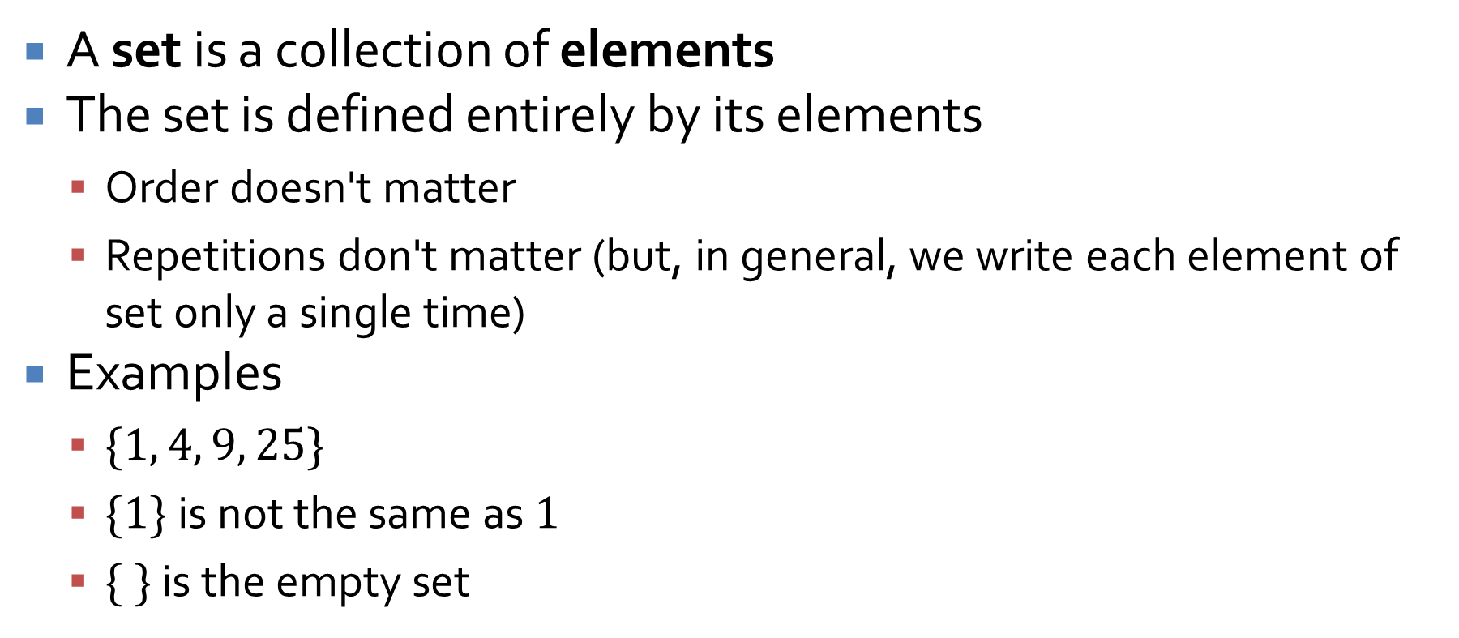
Sets
A set is a collection of elements
The set is defined entirely by its elements
Order doesn't matter
Repetitions don't matter (but, in general, we write each element of set only a single time)
Examples
$\{1, 4, 9, 25\}$
$\{1\}$is not the same as $1$
$\{ \}$ is the empty set

Slide 27
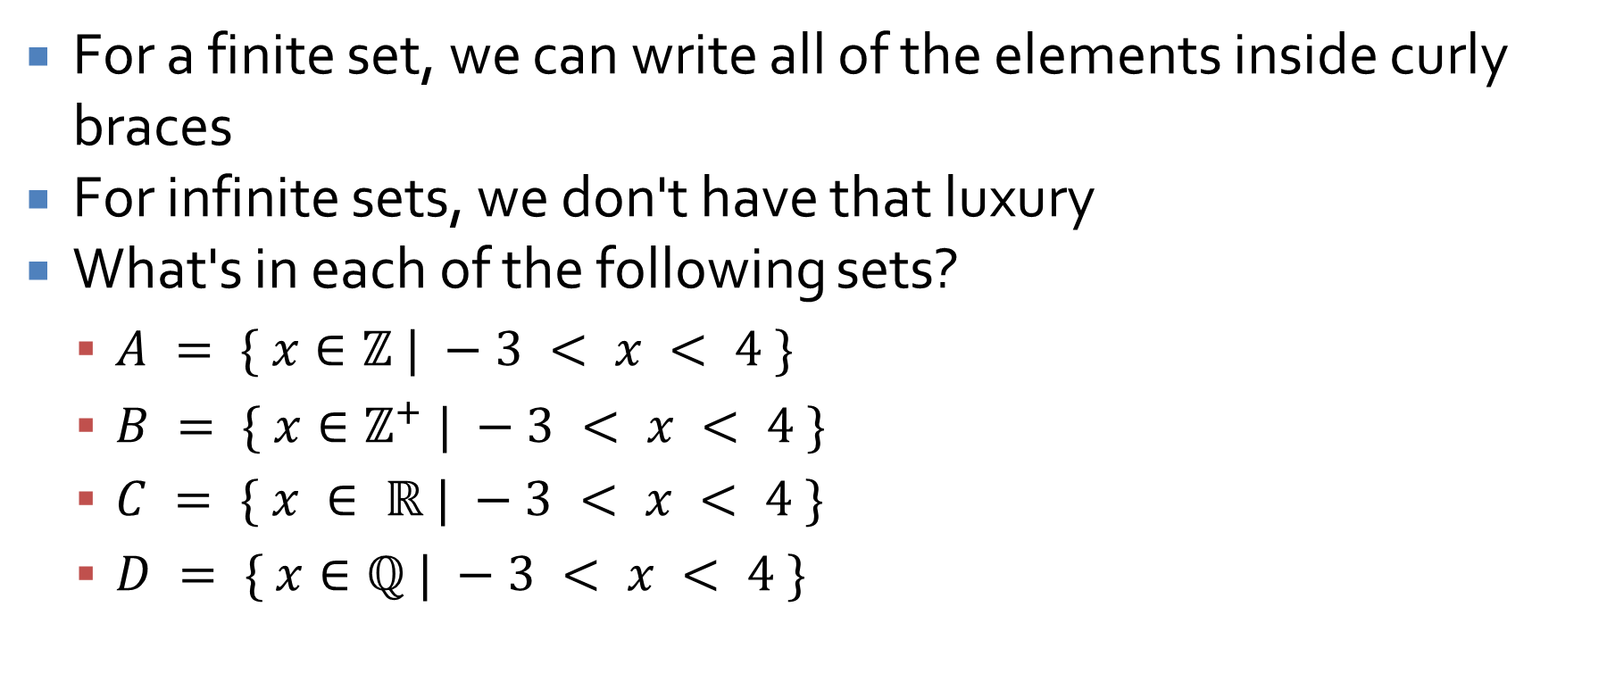
Notation
For a finite set, we can write all of the elements inside curly braces
For infinite sets, we don't have that luxury
What's in each of the following sets?
$A = \{ x∈ℤ | −3 < x < 4 \}$
$B = \{ x∈ℤ^{+} | −3 < x < 4 \}$
$C = \{ x ∈ ℝ | −3 < x < 4 \}$
$D = \{ x∈ℚ | −3 < x < 4 \}$

Slide 28
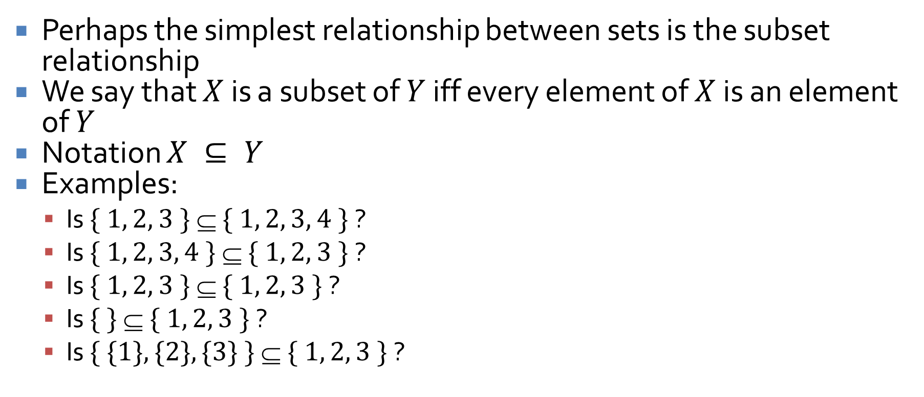
Subsets
Perhaps the simplest relationship between sets is the subset relationship
We say that $X$ is a subset of $Y$ iff every element of $X$ is an element of $Y$
Notation $X ⊆ Y$
Examples:
Is $\{ 1, 2, 3 \}  \{ 1, 2, 3, 4 \}$?
Is $\{ 1, 2, 3, 4 \}  \{ 1, 2, 3 \}$?
Is $\{ 1, 2, 3 \}  \{ 1, 2, 3 \}$?
Is $\{ \}  \{ 1, 2, 3 \}$?
Is $\{ \{1\}, \{2\}, \{3\} \}  \{ 1, 2, 3 \}$?

Slide 29
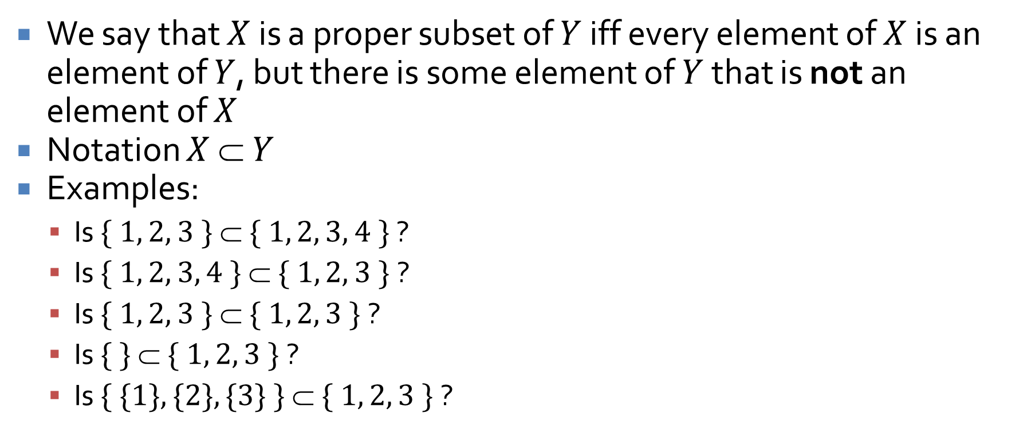
Proper subsets
We say that $X$ is a proper subset of $Y$ iff every element of $X$ is an element of $Y$, but there is some element of $Y$ that is not an element of $X$
Notation $X  Y$
Examples:
Is $\{ 1, 2, 3 \}  \{ 1, 2, 3, 4 \}$ ?
Is $\{ 1, 2, 3, 4 \}  \{ 1, 2, 3 \}$?
Is $\{ 1, 2, 3 \}  \{ 1, 2, 3 \}$?
Is $\{ \}  \{ 1, 2, 3 \}$?
Is $\{ \{1\}, \{2\}, \{3\} \}  \{ 1, 2, 3 \}$?

Slide 30
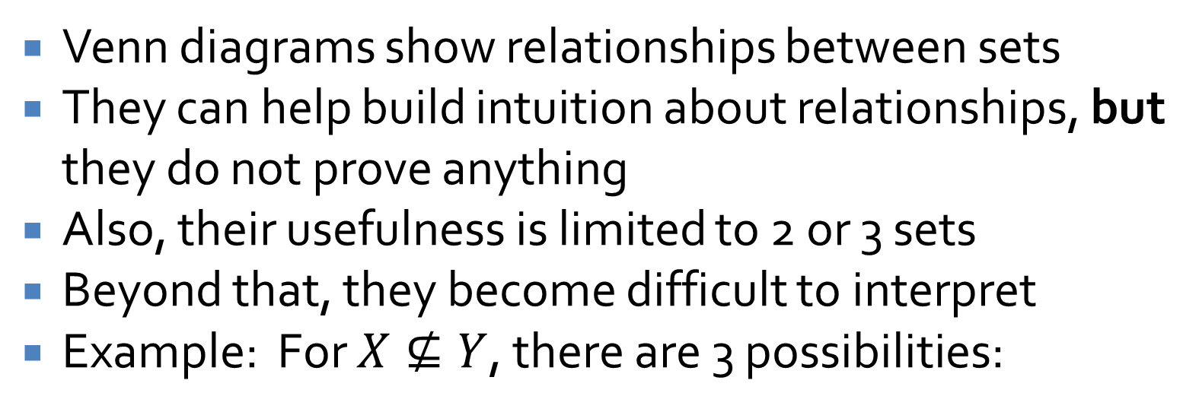
Venn diagrams
Venn diagrams show relationships between sets
They can help build intuition about relationships, but they do not prove anything
Also, their usefulness is limited to 2 or 3 sets
Beyond that, they become difficult to interpret
Example: For $X⊈Y$, there are 3 possibilities:
X
X
Y
X
Y
Y

Slide 31
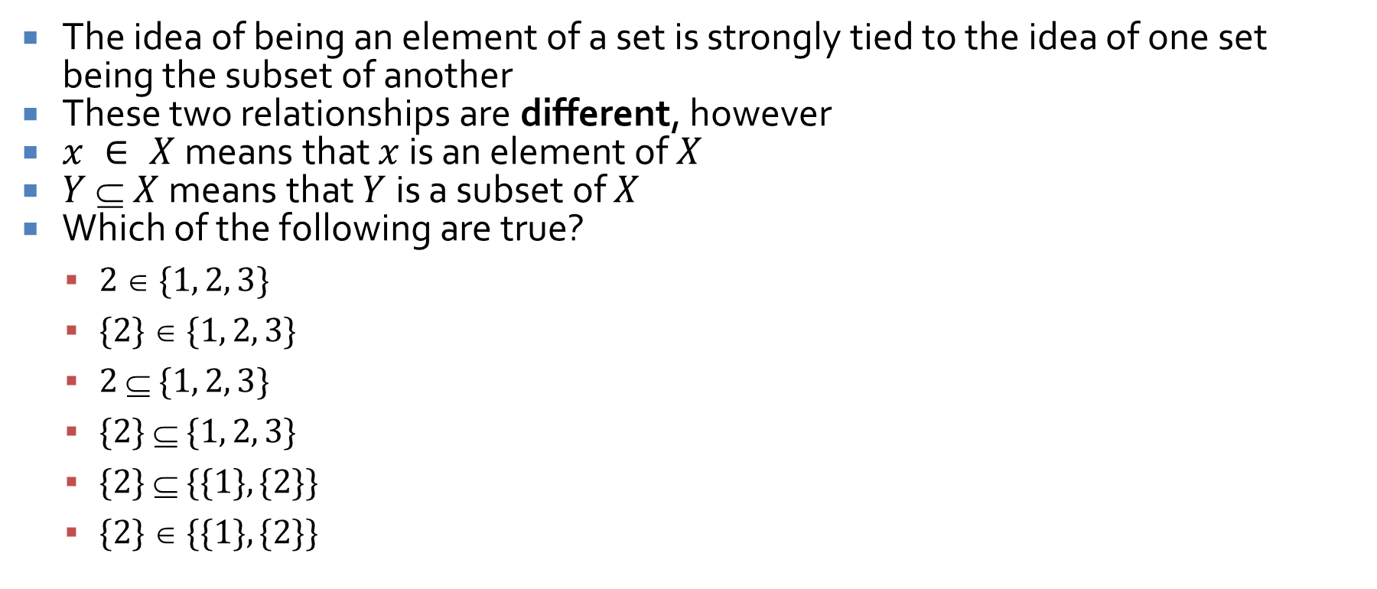

$∈$ vs. $⊆$
The idea of being an element of a set is strongly tied to the idea of one set being the subset of another
These two relationships are different, however
$x ∈ X$means that $x$ is an element of $X$
$Y  X$means that $Y$ is a subset of $X$
Which of the following are true?
$2  \{1, 2, 3\}$
$\{2\}  \{1, 2, 3\}$
$2  \{1, 2, 3\}$
$\{2\}  \{1, 2, 3\}$
$\{2\}  \{\{1\}, \{2\}\}$
$\{2\}  \{\{1\}, \{2\}\}$

Slide 32
Ticket Out the Door

Slide 33
Upcoming

Slide 34
Next time…
Properties of sets
Proofs with sets
Russell's paradox and the Halting Problem

Slide 35
Reminders
Finish Assignment 2
Due tonight!
Assignment 3 is due next Friday
Read 6.2, 6.3, and 6.4

